Slide 1
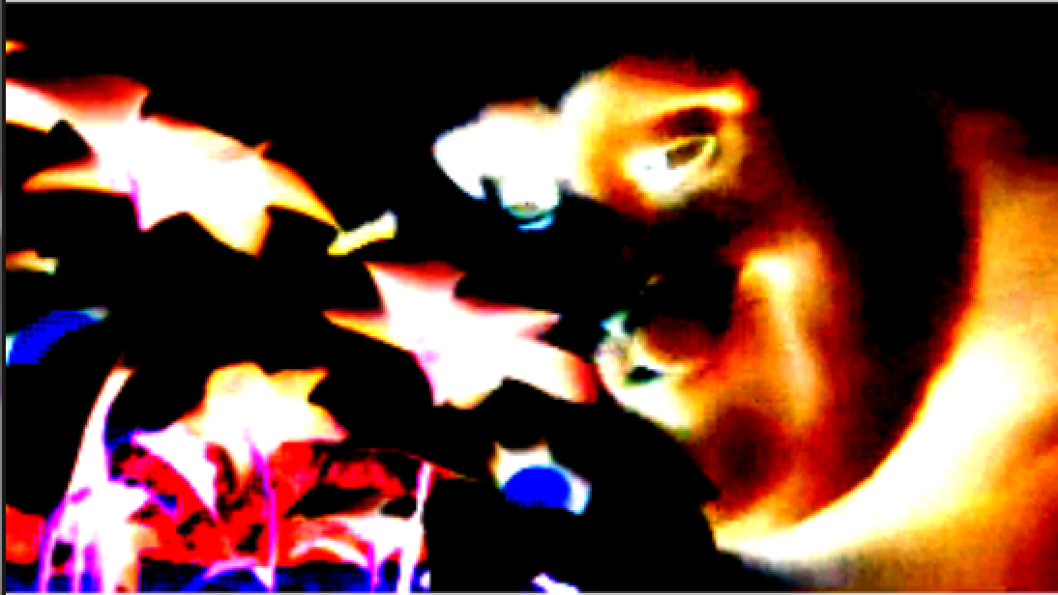
Processing 2D Images and Videos with Texture Operators (TOPs) Part 1
David Meredith
dave@create.aau.dk

Slide 2
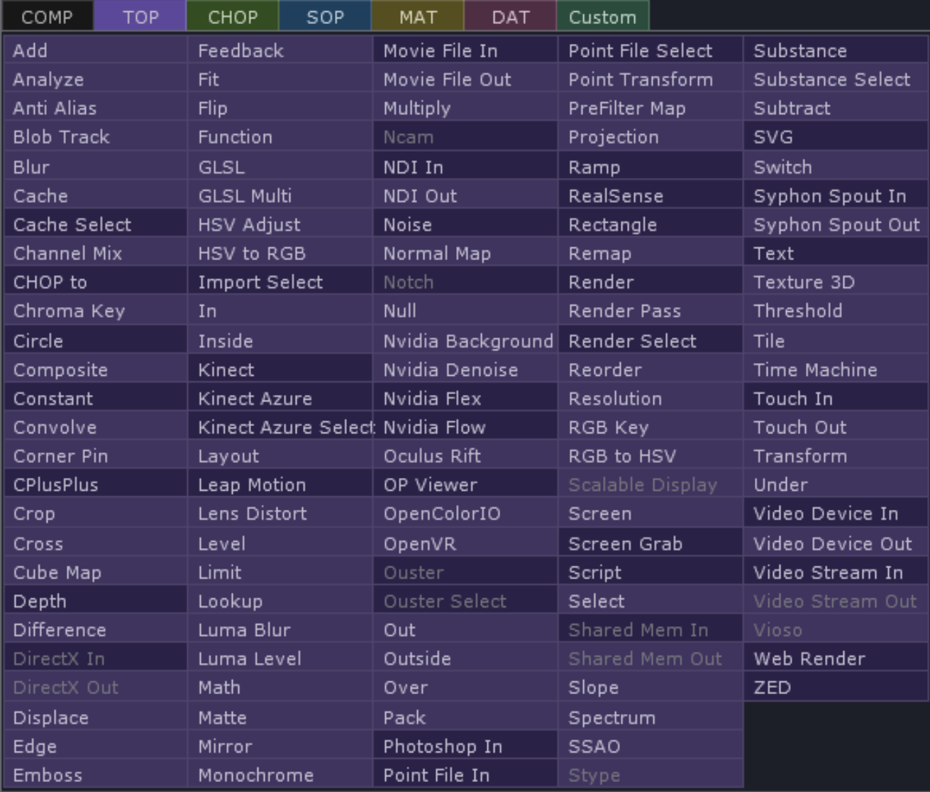
Texture Operators (TOPs) https://docs.derivative.ca/TOP
TOPs are image operators that provide real-time GPU-based compositing and image manipulation
Used for
Preparing textures
Compositing streams, images and movies
Building control-panel elements
Manipulating 32-bit floating point data
…and lots of other stuff
Support many formats, including floating-point image formats for working with HDR images

Slide 3
Texture Operators (TOPs) https://docs.derivative.ca/TOP
All renders and composites occur offscreen with TOPs
Data can be scaled to any resolution, limited only by hardware
TOPs can hold point cloud data where each pixel holds 32-bit XYZ coordinates
Right-click on viewer and select View as Points
Non-commercial limited to 1280 x 1280 resolution

Slide 4
Texture Operators (TOPs) https://docs.derivative.ca/TOP
127 TOPs in the OP CREATE dialog
Some are greyed out in the non-commercial version
Ones with a darker background generate textures
Ones with lighter background filter textures to produce new textures
All TOPs documented at: https://docs.derivative.ca/Category:TOPs

Slide 5
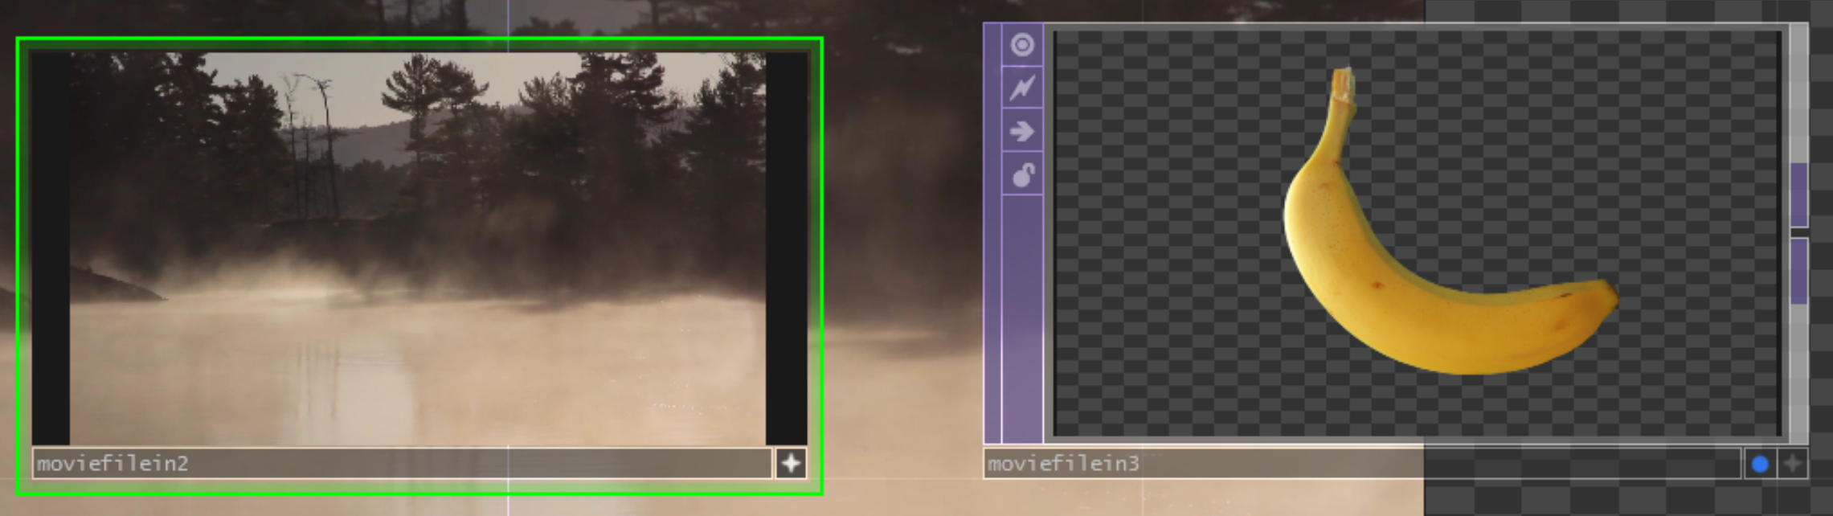
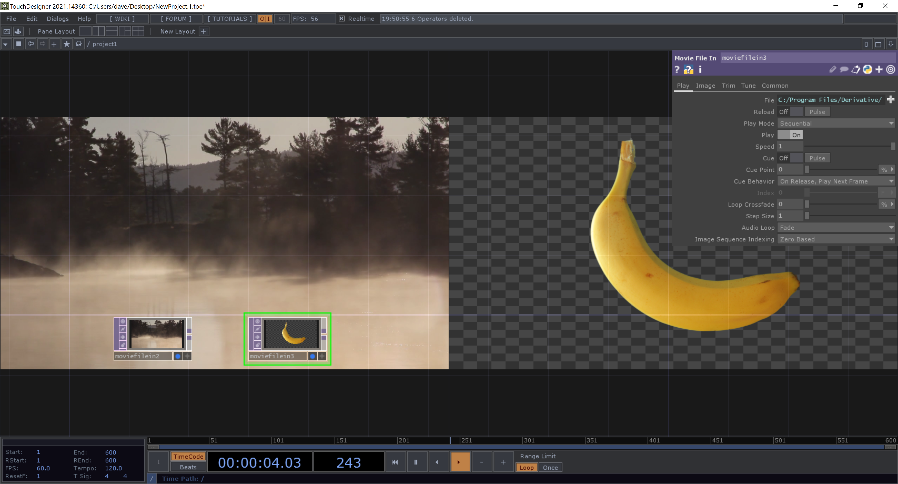
TOP flags
Viewer active flag
Display flag
A TOP has two flags in its bottom right-hand corner:
Display flag
Displays TOP output as background of network pane
Turning on display flag on multiple TOPs causes all of them to be displayed side-by-side as the background
Viewer Active flag

Slide 6
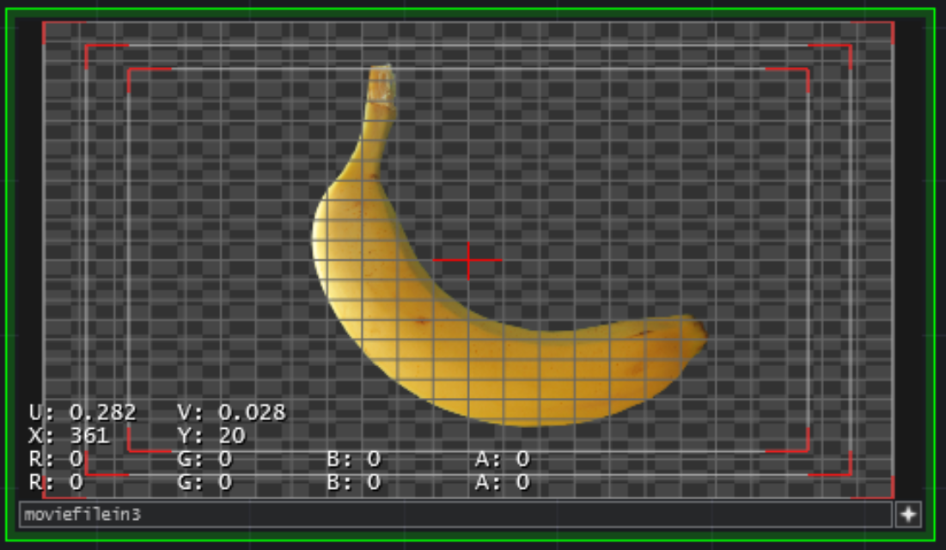
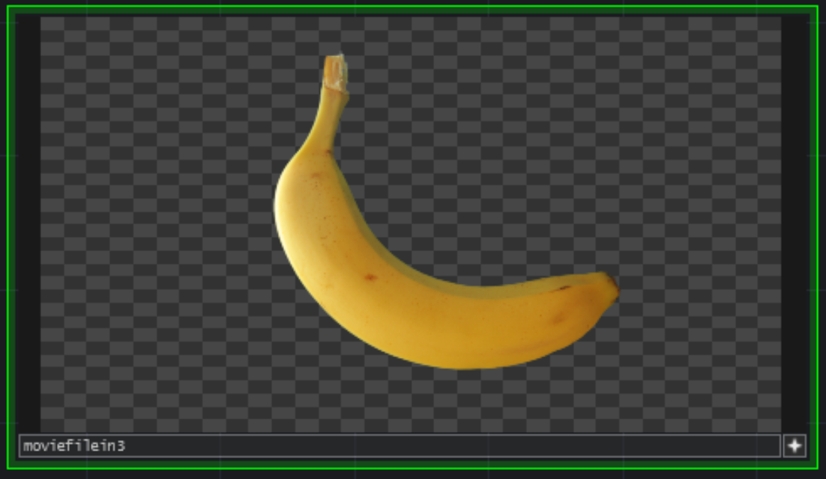
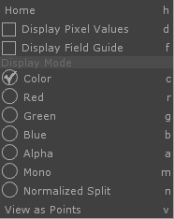
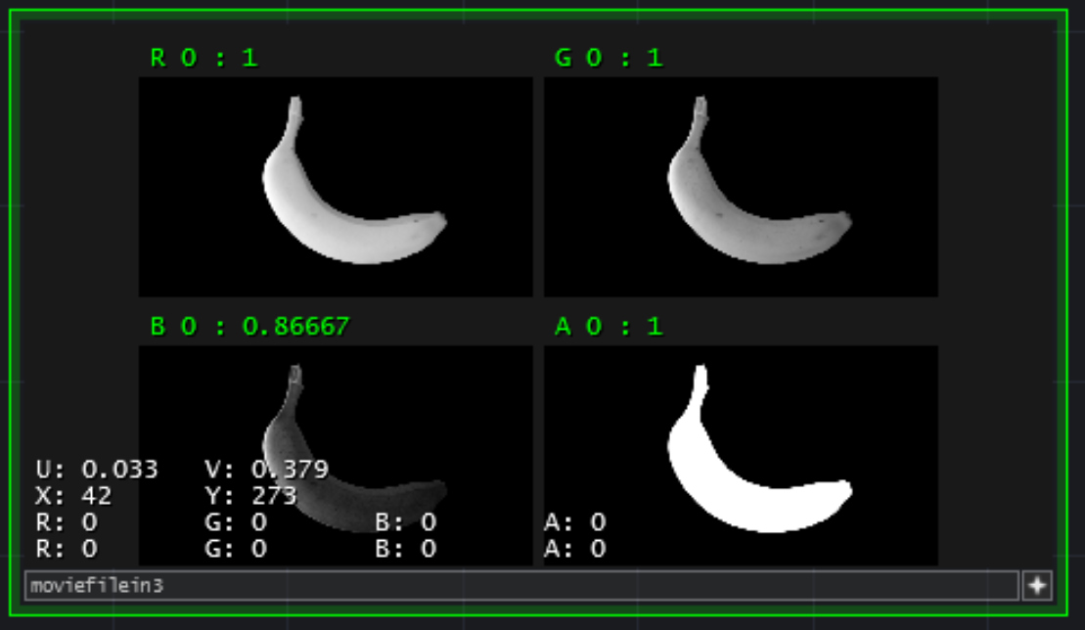
TOP Viewers
TOPs have interactive Node Viewers
Need to have Viewer Active Flag on in order to interact with a TOP’s node viewer
If alpha channel present, then you’ll see a grey checkerboard background
Turn off in TOPs tab in Preferences, accessible through the main Edit menu (or the TouchDesigner menu on a Mac)
LMB: move around inside a viewer
MMB: zoom in and out (or Option–RMB, then drag left and right)
”h”: recenter image in viewer
RMB: opens viewer options menu
Let's you see each color channel separately or in parallel or view the contents of the TOP as a set of points

Slide 7
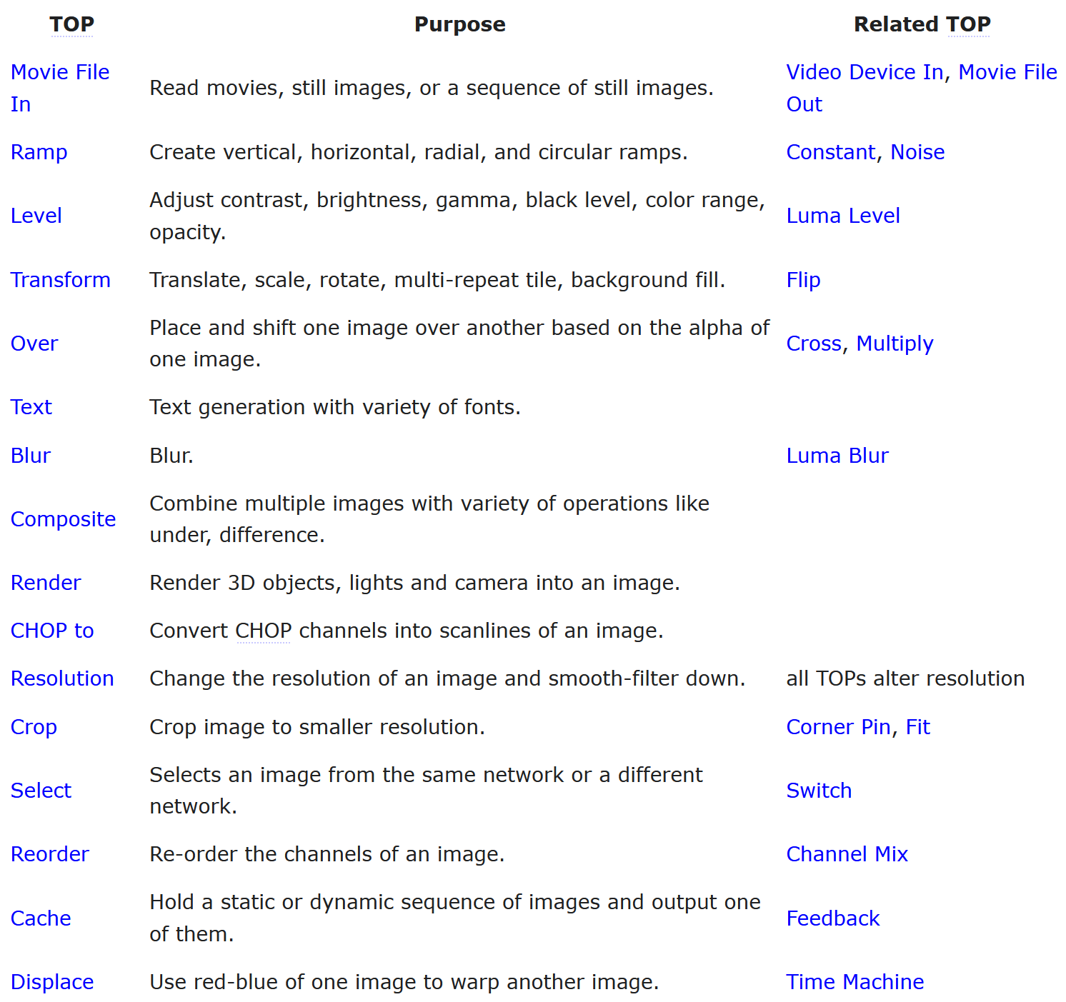
Sweet Sixteen TOPs https://docs.derivative.ca/TOP#Sweet_16_TOPs
The Sweet Sixteen TOPs are a set of 16 TOPs that are commonly used

Slide 8
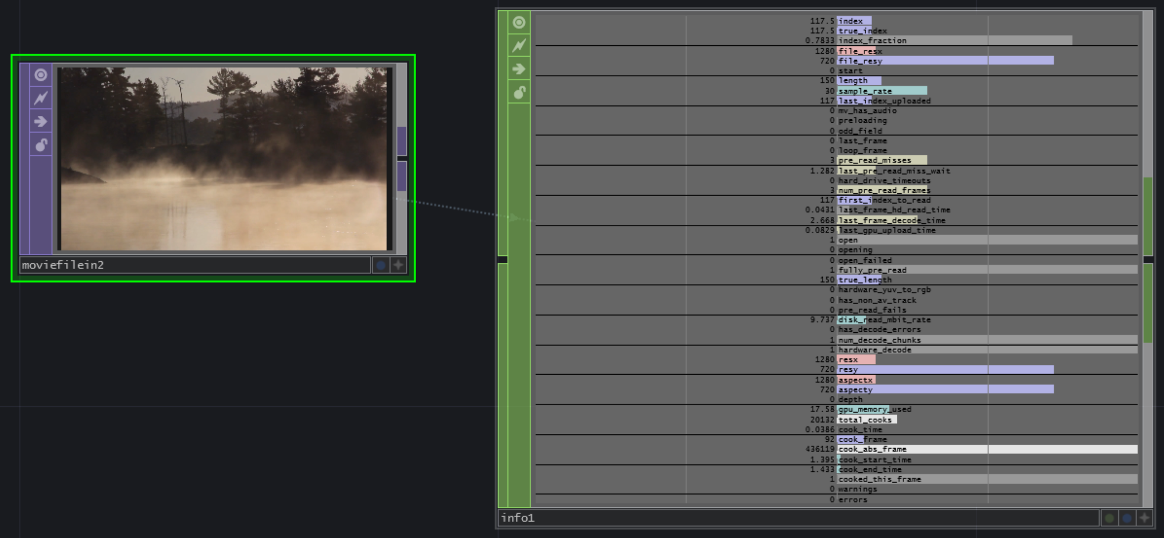
Movie File In TOP https://docs.derivative.ca/Movie_File_In_TOP
Used to load movies, images or sequences of images
Reads following image formats: jpg, gif, tif or bmp
Reads following movie formats. .mov, .mp4, .mpeg, .avi, .wmv, .dpx, Cineform, Hap Q, Hap Q with Alpha
Supports NotchLC codec, EXR files, some .swf and .flv Flash files, DXT1, 3 and 5 compressed DDS file
Can specify location as a URL to fetch movies or images from the web
Can view state of a Movie File In TOP by dropping it on an Info CHOP

Slide 9
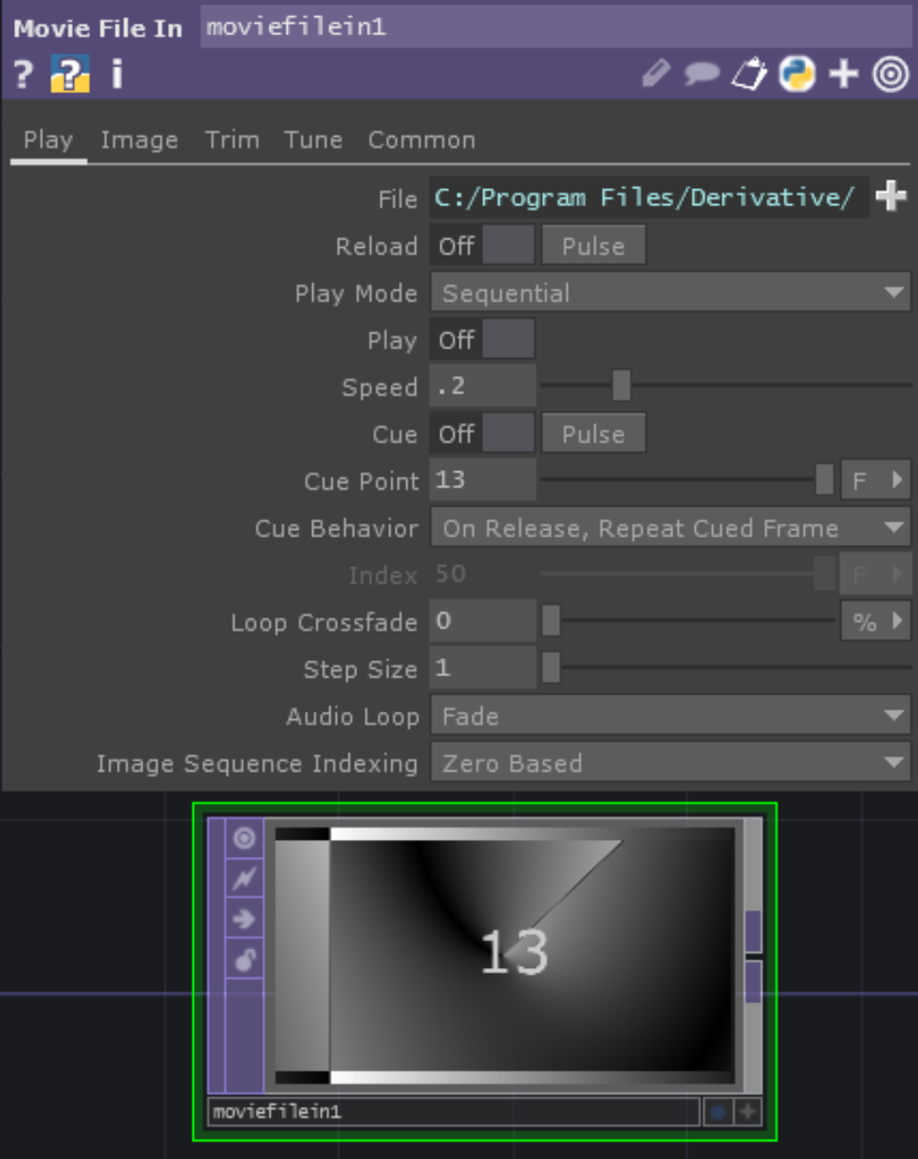
Movie File In parameters: Play page
Play page
File: Path and name of image or file to load; file types are given in https://docs.derivative.ca/File_Types; specify files on internet using a URL
Give name of a folder to load all images in folder as if they are one movie; all files must be the same resolution; order is alphanumeric; override sample rate on Trim page to playback sequence at any frame rate
Reload: Forces image or movie to reload, press pulse to instantly reload the file or the first file in a folder of images
Play mode
Sequential:
Runs movie at a speed determined by Speed parameter
If displaying a folder, then displays each file for a period determined by Speed parameter
Lock to Timeline:
Restarts presentation when Timeline restarts
Specify Index: Set Index parameter type to I, then gives just index of file in collection being displayed; if type set to F, then file shown determined by position of frame in whole cycle.
Play: On or off (not available when Locked to Timeline
Speed: Determines speed of display of movie or collection of files
Cue: Only works with Sequential, jumps to cue point when on; pulse button returns to cue point
Cue point: Can be expressed as percentage, index, frames or seconds
Index: used with play mode Specify Index to explicitly set movie position
Loop crossfade: crossfades beginning and ending of movie to get smooth transition
If use Trim options, then crossfades Trim Start with Trim End positions
Step size: Sets number of frames to skip between displaying frames

Slide 10
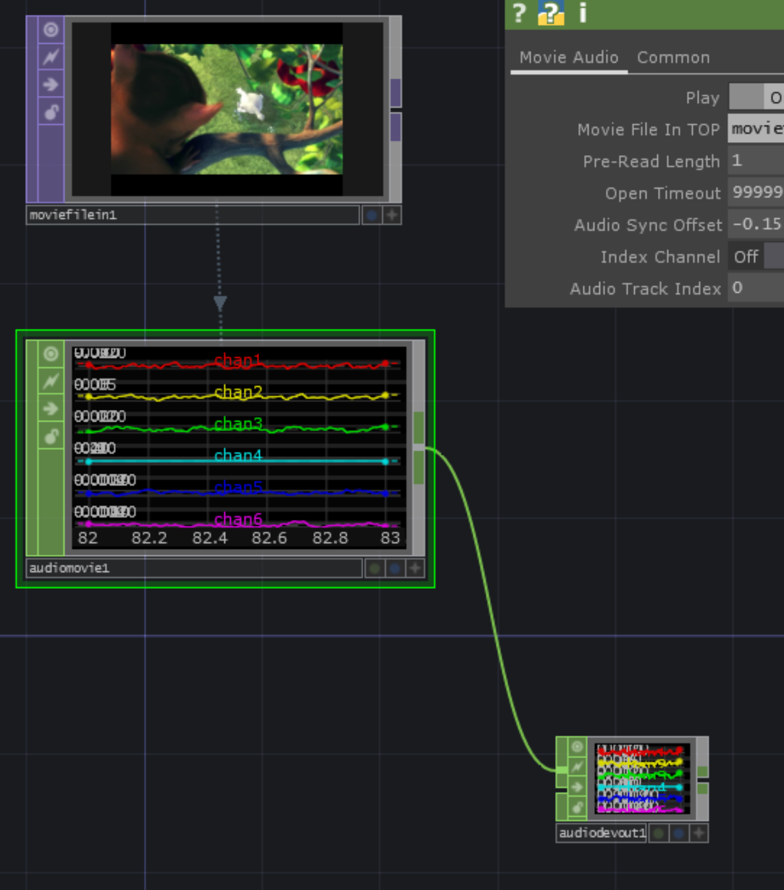
Playing movies with audio
Attach a Movie File In TOP to an Audio Movie CHOP by dragging the Movie File In TOP onto the Audio Movie CHOP
Then attach the Audio Movie CHOP to an Audio Device Out Chop
Make sure that the Device parameter is referring to the right speakers or headphone and that the Driver parameter is using the correct driver

Slide 11
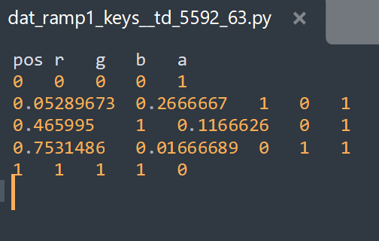
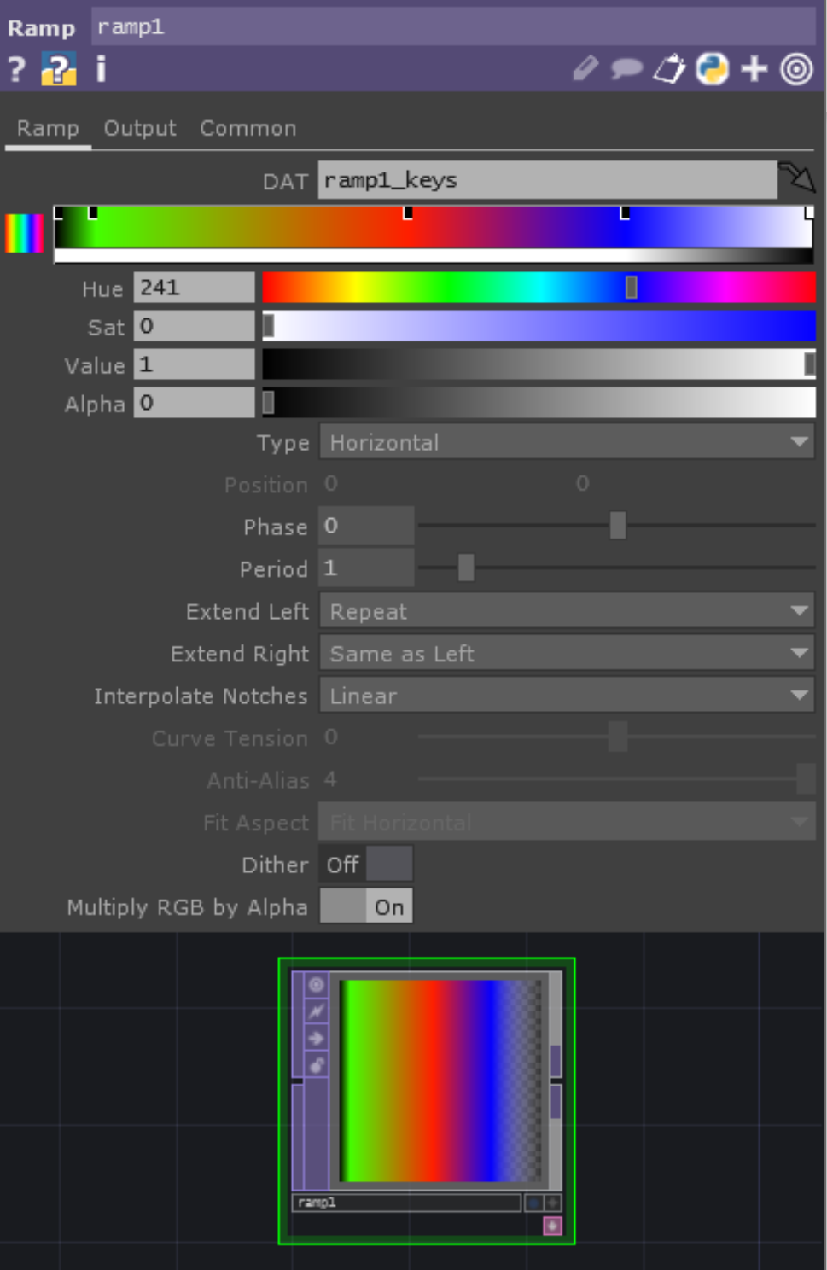
Ramp TOP https://docs.derivative.ca/Ramp_TOP
Allows you to interactively create vertical, horizontal, radial or circular ramps
Use the ramp bar and color-picker to add keyframes and define the colors at those frames
Drag a keyframe off the ramp bar to remove it
Data for ramp is held in DAT specified in DAT parameter
Each row represents a color keyframe entry in the ramp
Use Option/Alt - A to scroll in DAT

Slide 12
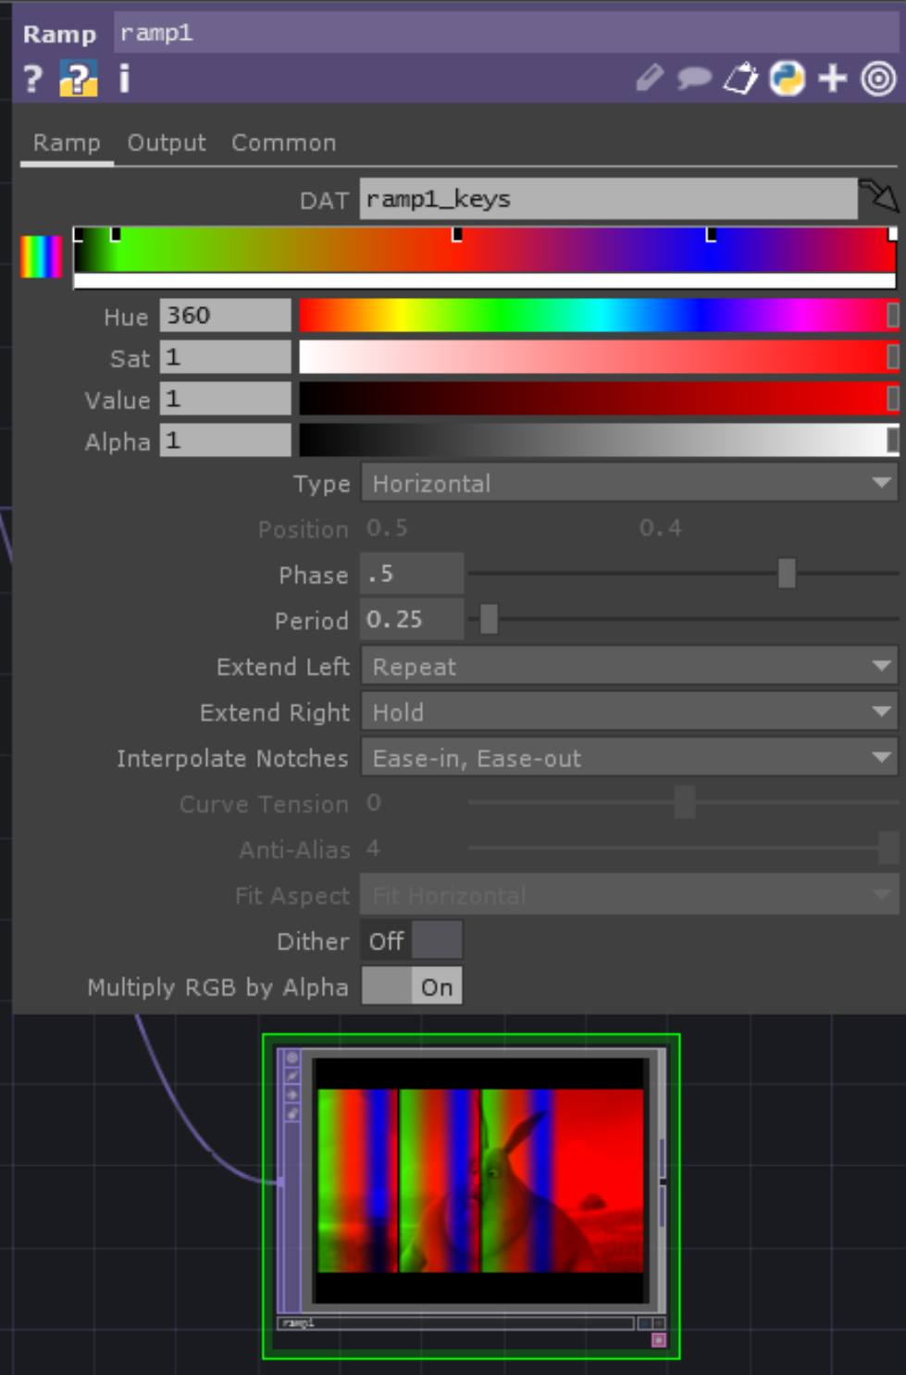
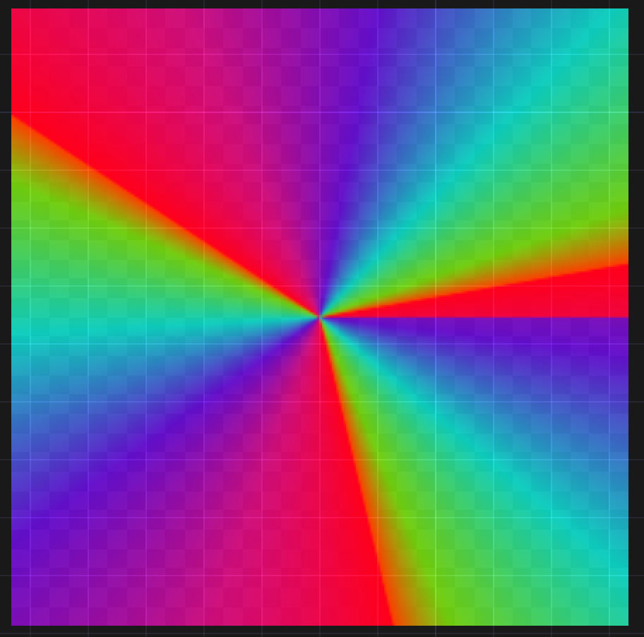
Ramp TOP parameters
Ramp page
Type: vertical, horizontal, radial, circular
Position: sets centre position for radial and circular ramps
(0,0) is centre, (.5,.5) is approx top right corner
Phase: starts the ramp shifted by a proportion of its period
Period: determines width of one period of ramp in image/movie, so smaller period means more repetitions of the ramp

Slide 13
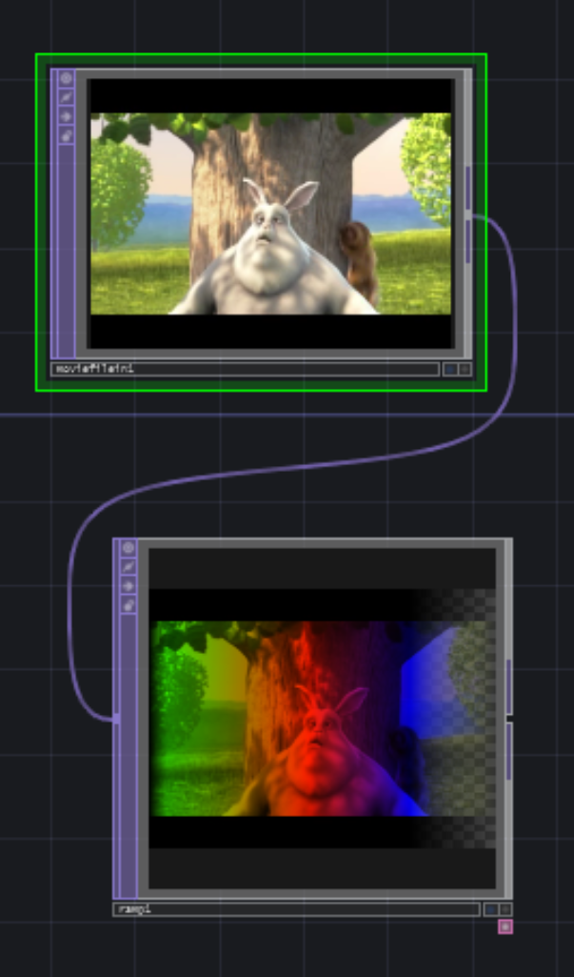
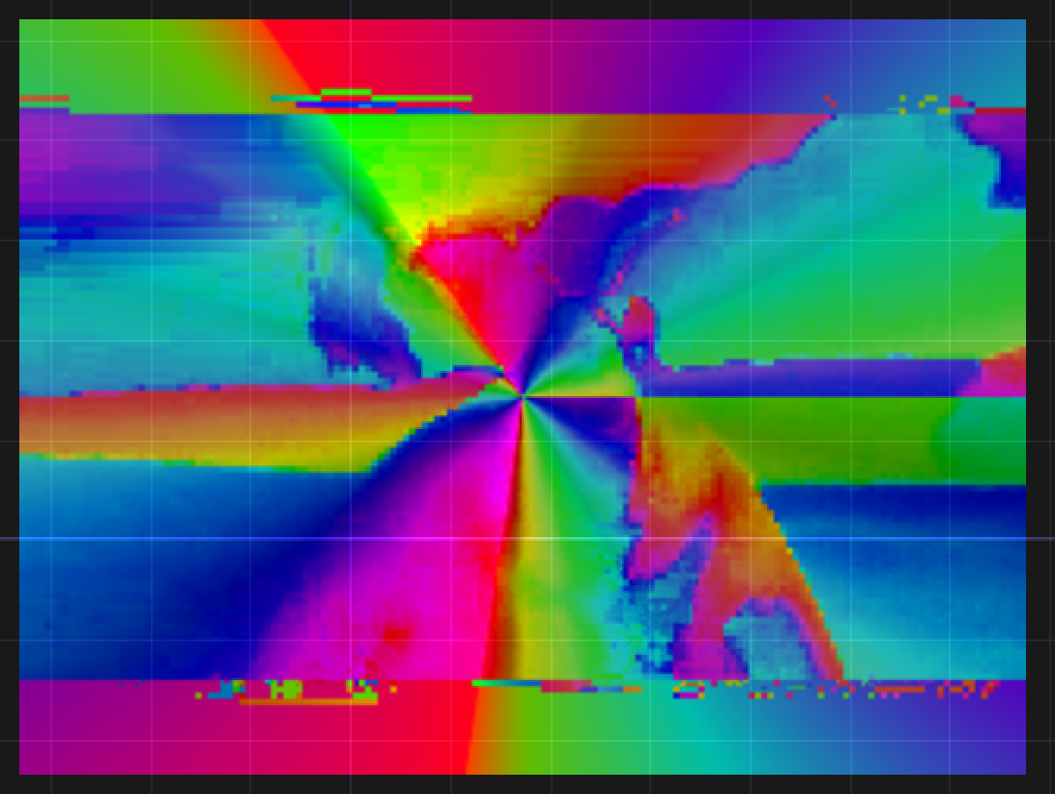
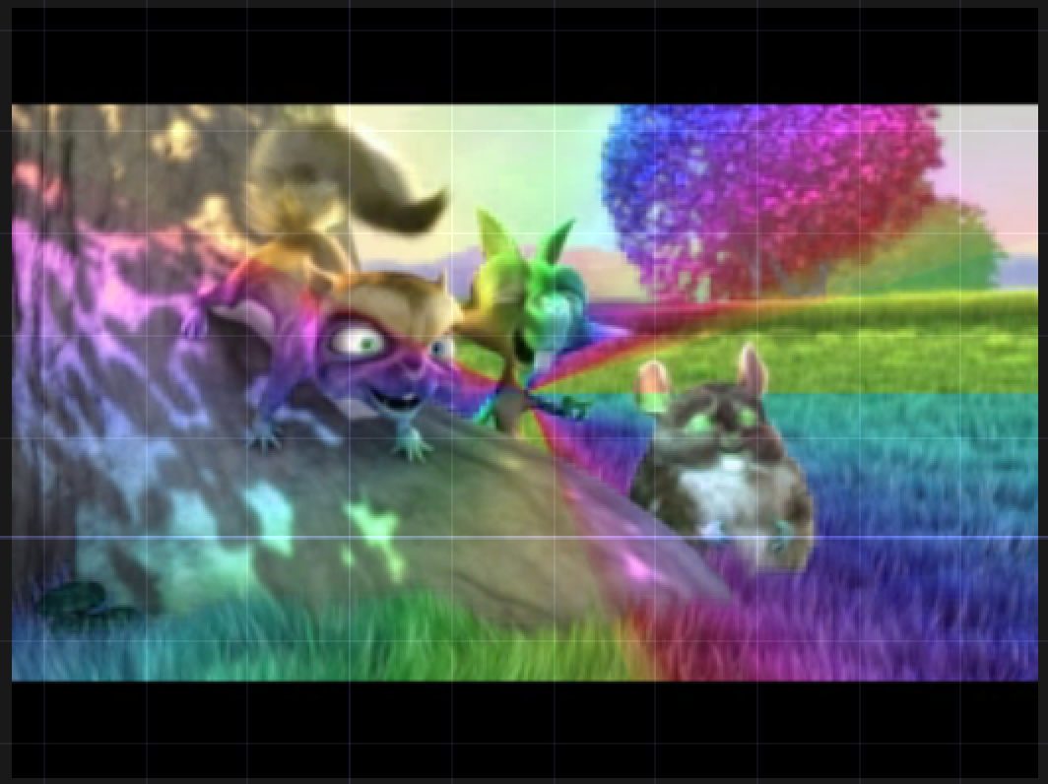
Ramp TOP parameters
Output page
Comp with Input: if on, composites input movie or image with ramp
Operation: Choose the composite operation that is performed
Swap order: Swaps order of composite with input
See effect by using Over or Chroma difference operation

Slide 14
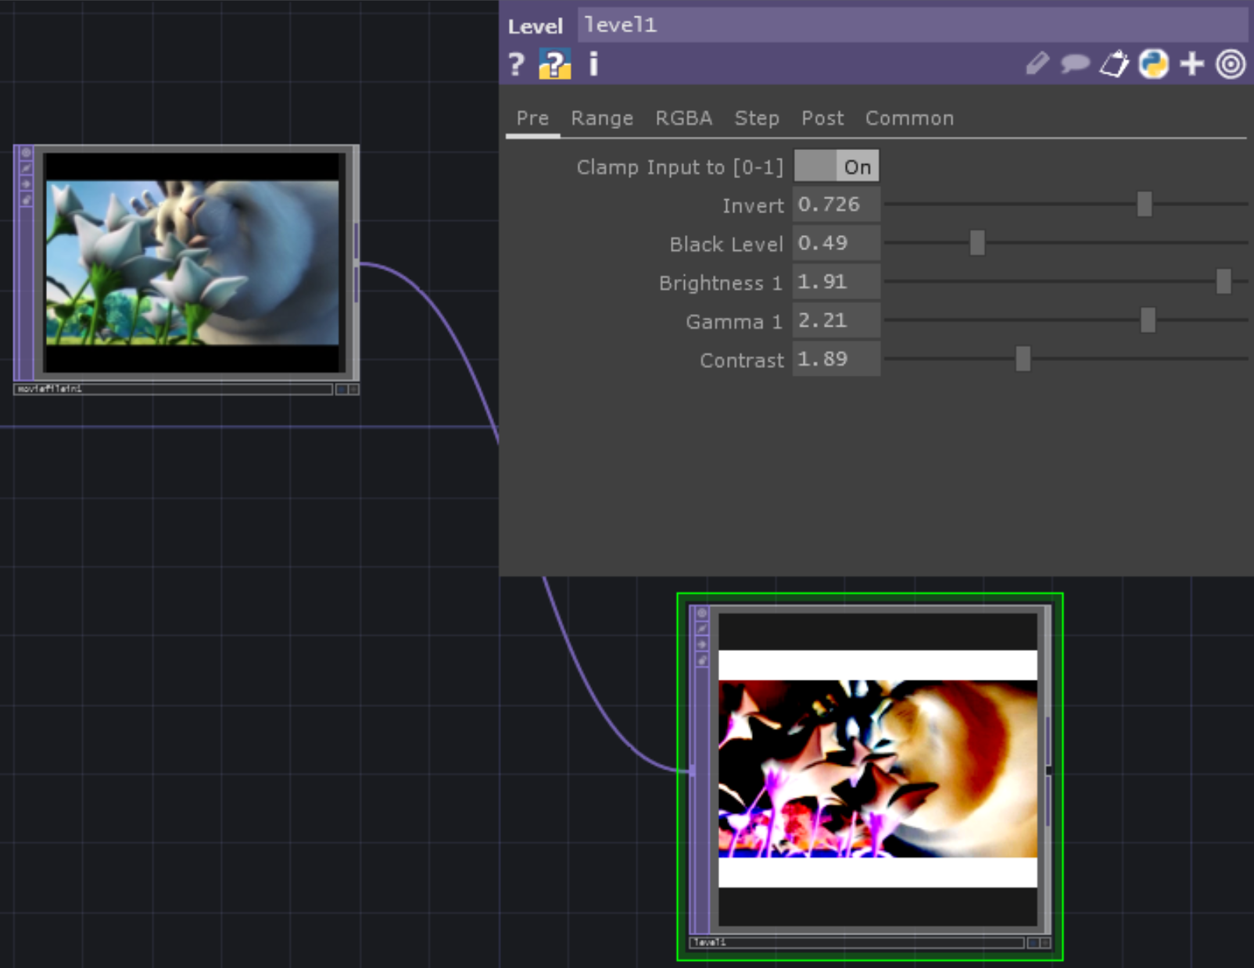
Level and Luma Level TOPs https://docs.derivative.ca/Level_TOP https://docs.derivative.ca/Luma_Level_TOP
Level TOP adjusts contrast, brightness, gamma, black level, color range, quantization, opacity and more
Luma Level TOP preserves hue and saturation more accurately

Slide 15
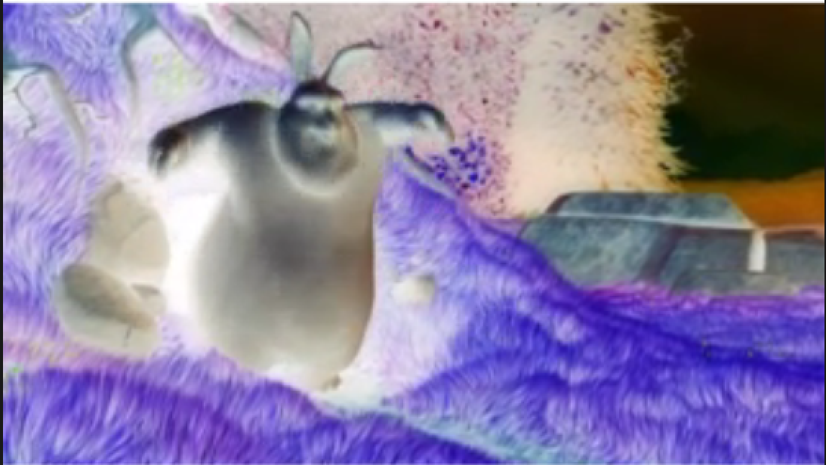
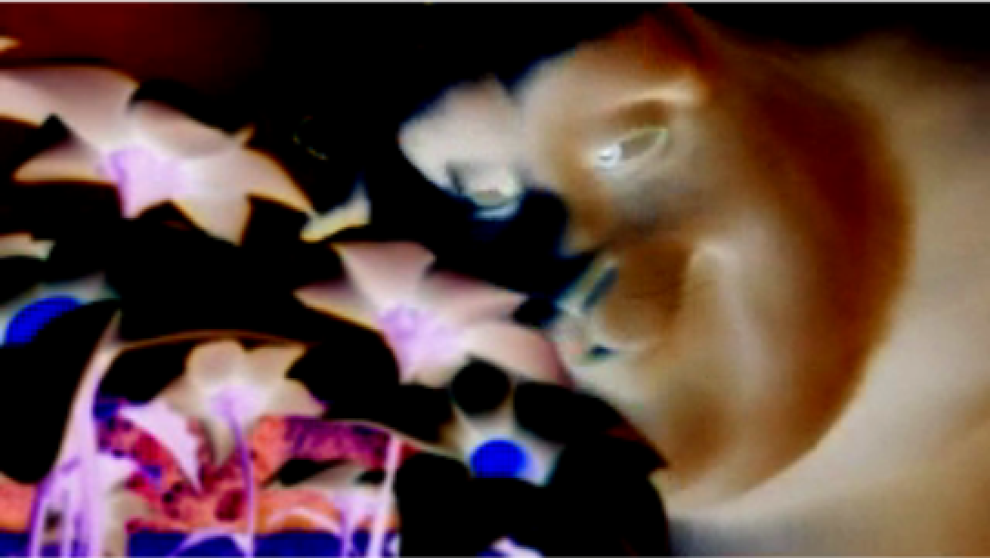
Level TOP Parameters – Pre Page
Clamp Input to [0-1]: clamps pixel values to be within the range 0 to 1 (do not use with higher bit depth floating point pixel formats)
Invert: inverts colors, so that black becomes white and colors are inverted across the color wheel (red -> cyan, blue -> yellow, green -> magenta, etc.)
Black level: blackens any pixel with a value below the given value
Brightness 1: Brightness is mean of RGB channel values for a pixel. Increasing brightness adds amounts to these channels to maintain relative amounts of R G and B, but raising average
Gamma 1: Gamma is relationship between brightness of a pixel on the screen and its numerical value. Defined by a curve. Changing gamma changes relationship between R, G and B because eyes are not equally sensitive to red, green and blue
Contrast: applies a scale factor to the RGB channels – brightens lighter areas and darkens darker areas

Slide 16
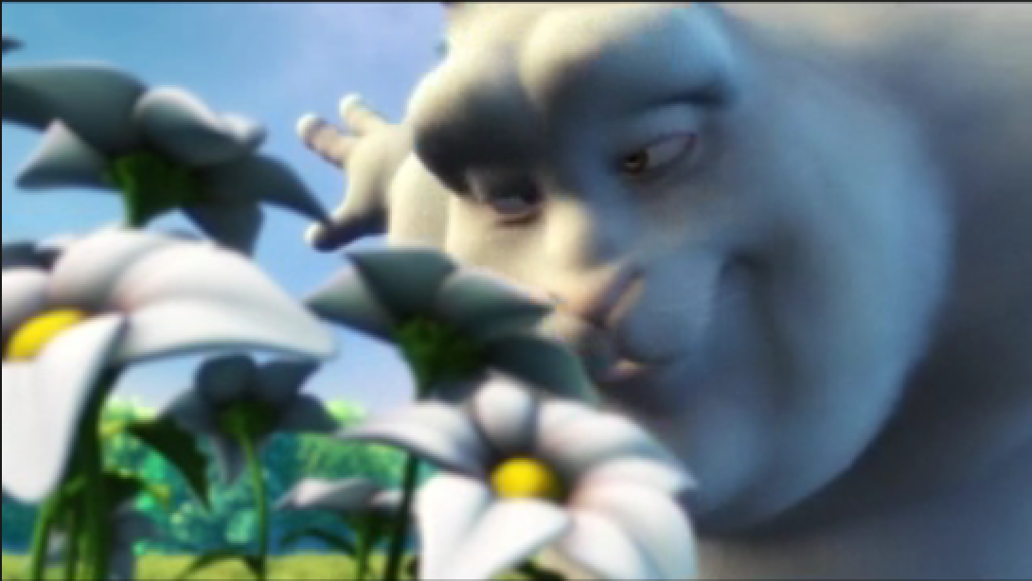
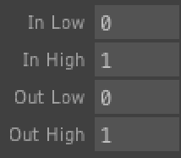
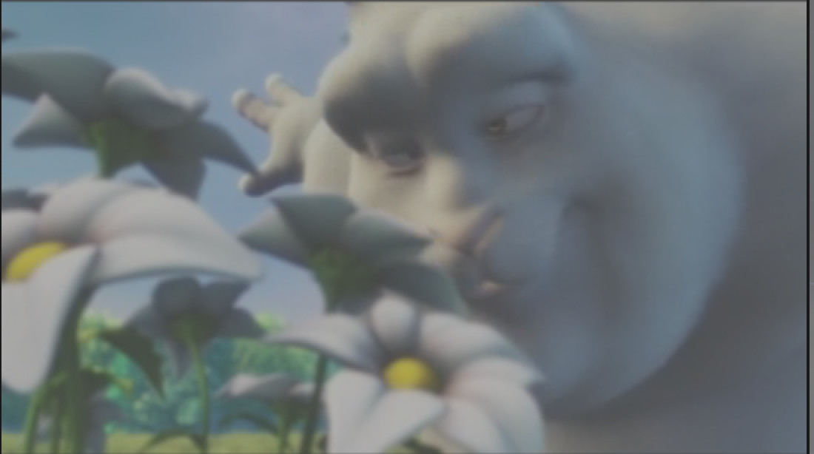
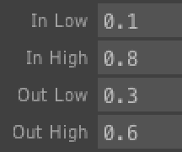
Level TOP – Range Page
In Low – Everything below this level is black in the output
In High – Everything above this level is white in the output
Out Low – Everything between In Low and Out Low is at the value of Out Low
Out High – Everything between In High and Out High is at the value of Out High

Slide 17
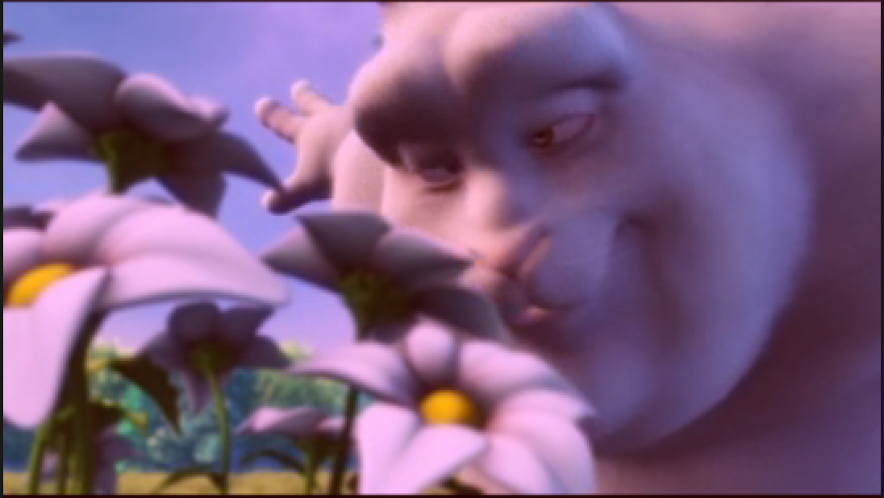
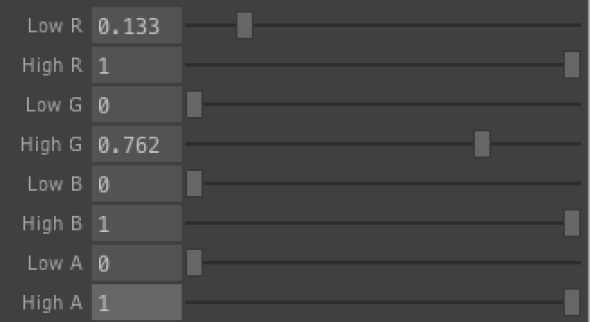
Level TOP – RGBA Page
Lets you clamp the minimum and maximum values of each channel in the image or video

Slide 18
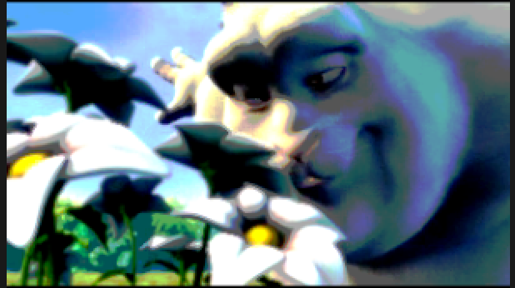
Level TOP – Step Page
“Stepping” is also known as “posterizing”
Apply Stepping turns stepping on
Step size – Posterizes image into bands” or “stripes” – divides range of values into bands of this size and replaces every pixel with a value within a band with the midpoint of that band
Threshold – shifts the lowest edge of the lowest band by the given amount (so -1 shifts all bands below 0, making the image disappear
Clamp Low/High – clamps all values below/above the given value to the given value
Soften – blurs the boundaries between the value bands

Slide 19

Level TOP - Post page
Parameters controlling second phase of processing by Level TOP
Gamma 2 – a second gamma correction, added after Range, RGBA and Step page adjustments have been made
Opacity – adjusts opacity of image or video
Brightness 2 – second brightness filter, added after Range, RGBA and Step
Clamp – clamps pixel values to this value or lower
Clamp Low/High – clamps image’s min/max values (where “value” is in the sense of “hue, saturation and value”

Slide 20
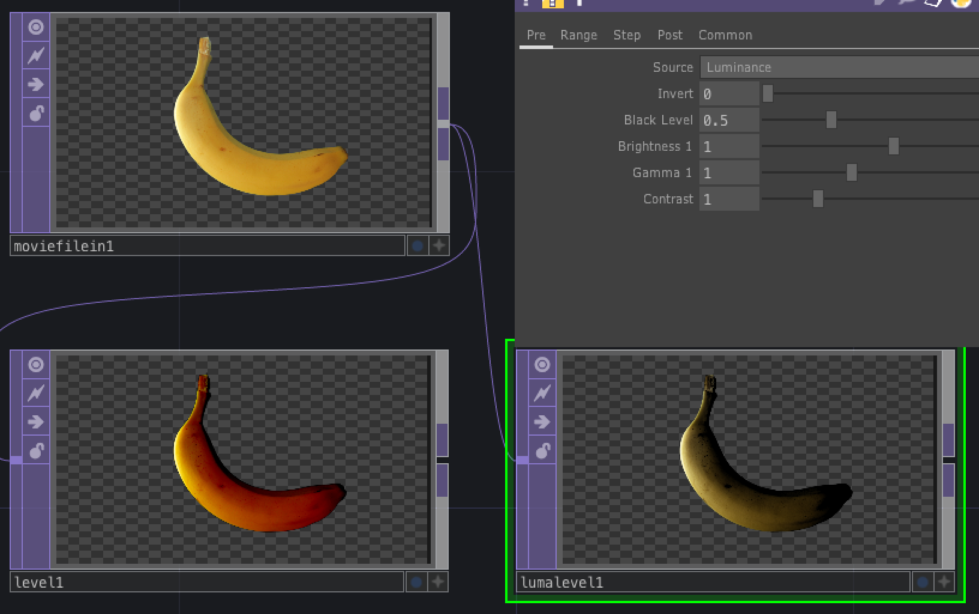
Luma Level
Has similar parameters to Level, but maintains hue and saturation more accurately when using Gamma and Black Level

Slide 21
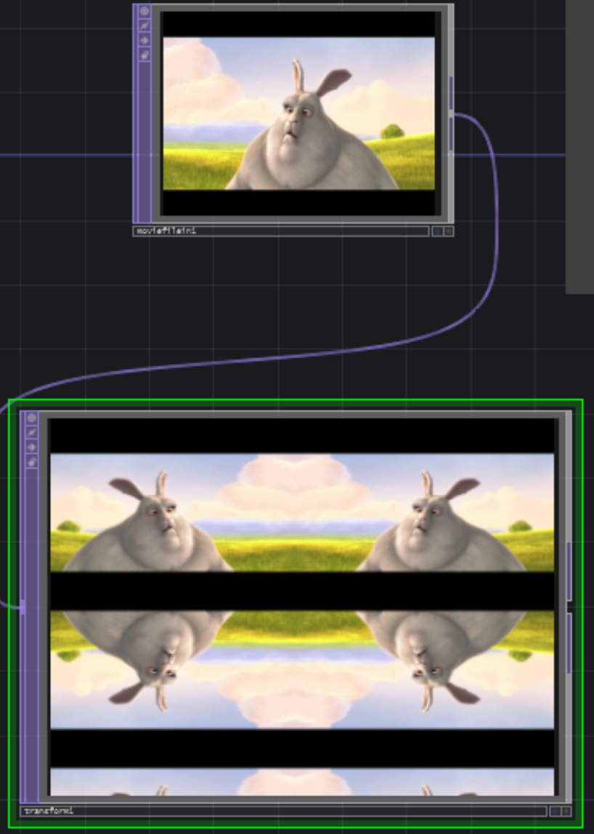
Transform TOP https://docs.derivative.ca/Transform_TOP
Applies 2D transformations to a TOP image or video (e.g., translate, scale, rotate, and multi-repeat tiling)
Background can be filled with solid color and alpha.
Tiling can be mirroring or repeating

Slide 22
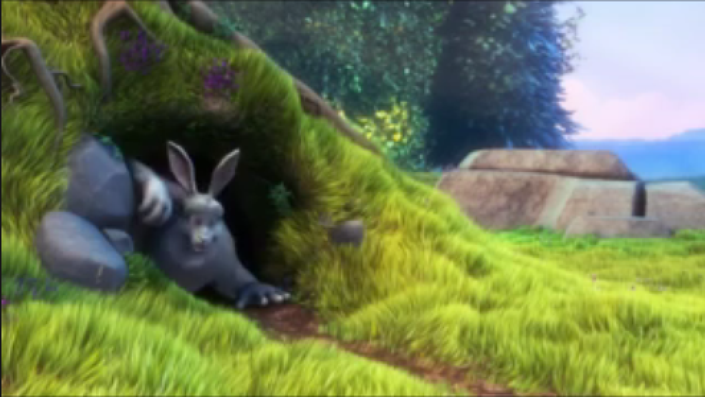
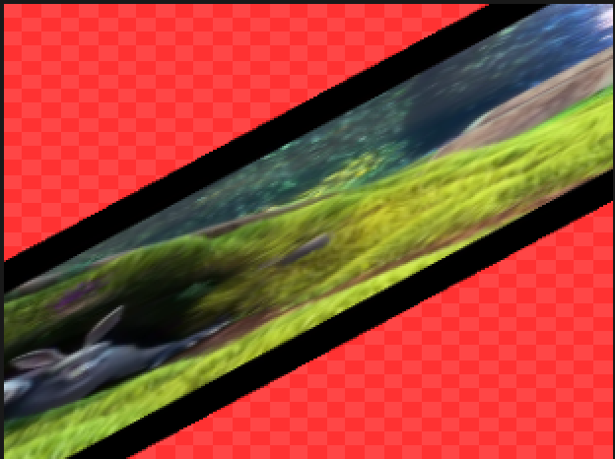
Transform TOP – Transform Page
Transform Order – determines the order in which the transformations are applied (e.g., “translate scale rotate” or “rotate scale translate”
Translate translates by the two values in the x and y direction respectively
Translate Unit – F = fraction, P = pixels, A = fraction aspect
Rotate – rotate by the given number of degrees
Scale – separate stretch factors for x and y axes
Grow/Shrink - Changes width and height by adding the specified number of pixels
Pivot – for defining the centre of rotation and scaling
Background color - color applied behind the foreground image. Background becomes visible when image is translated, scaled or sometimes rotate
Comp over Background color – Fill any area with the background color if it has alpha less than 1
Mipmap Bias – Indicates bias towards using certain mipmap levels:
0 – the levels that would normally be used
negative prefers higher levels (larger textures)
positive prefers lower levels (smaller textures)

Slide 23
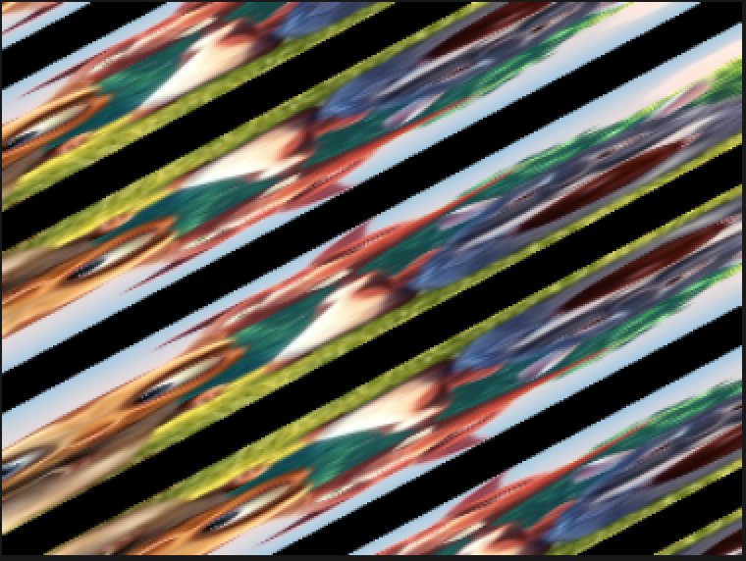
Transform TOP – Tile Page
Extend
Hold – extend pixel color at boundary over remainder of window
Zero – no extension – uncovered areas of window are transparent
Repeat – tile image to cover window
Mirror – repeat and reflect
Limit Tiles, Tile U and Tile V – gives limit to the number of times to repeat the image when tiling (negative is down and to the left)

Slide 24
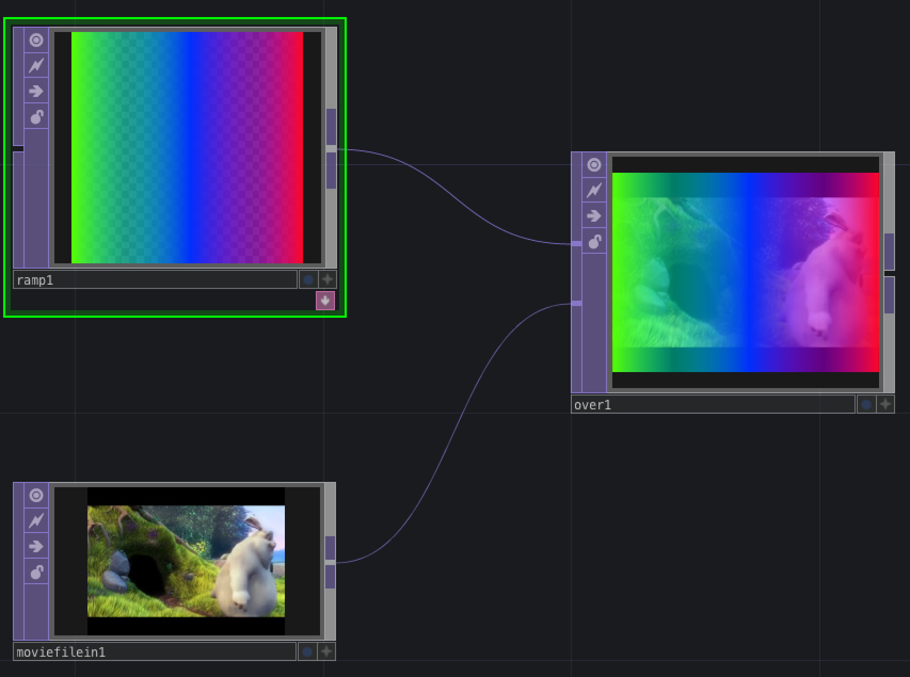
Over TOP https://docs.derivative.ca/Over_TOP
Places Input 1 over Input 2
Alpha of Input 1 determines what you can see of Input 2

Slide 25
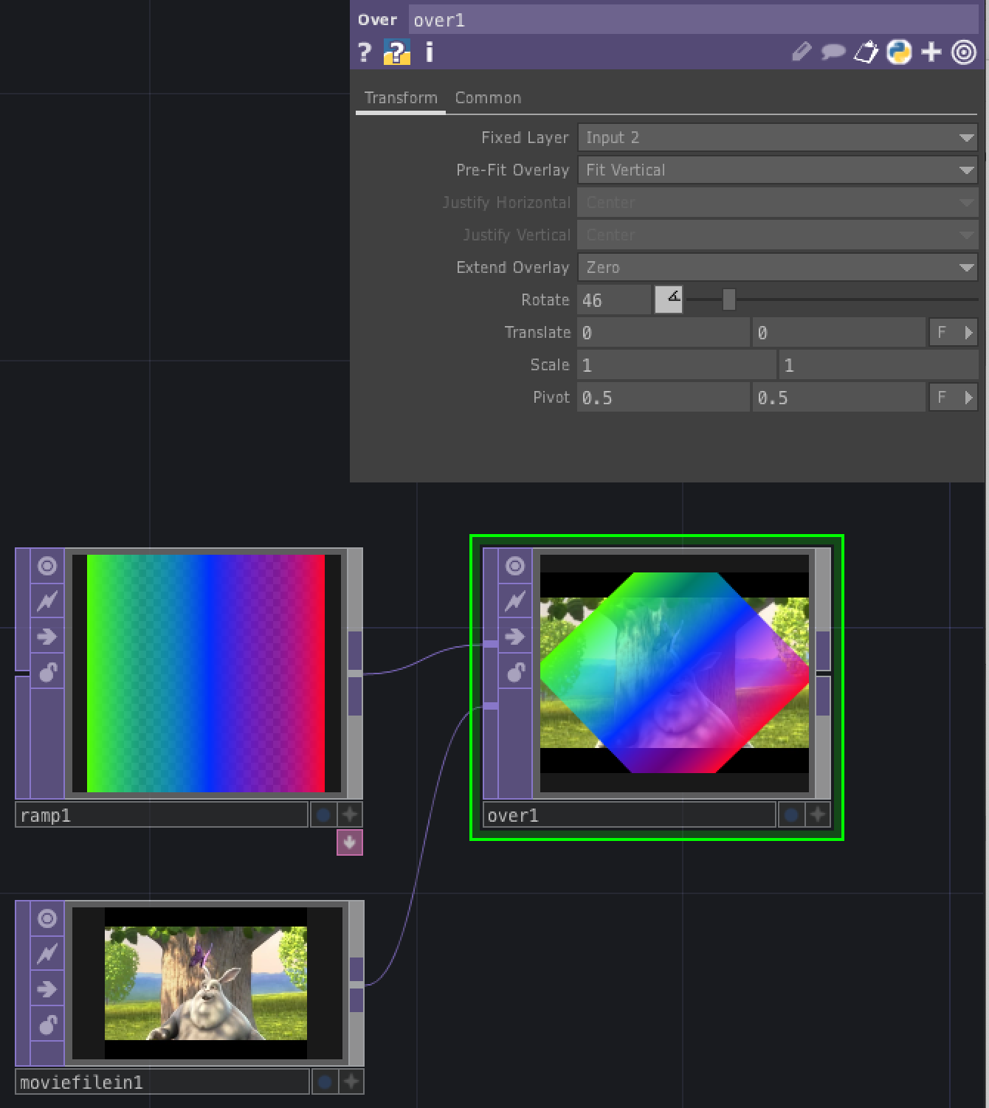
Over TOP – Transform Page
Fixed Layer – determines which layer is fixed and which is adjustable by using the parameters on the Transform page
Resolution and aspect ratio of final composite is that of the Fixed Layer
But remember that Input 1 is always on top!
Pre-Fit Overlay – determines how Overlay layer (not Fixed Layer) fills the composite
Justify Horizontal/Vertical – specify the horizontal/vertical alignment of the Overlay layer
Extend Overlay – sets extend or repeat conditions of the Overlay
The remaining parameters only affect the Overlay:
Rotate, Translate, Translate Units, Scale, Pivot, Pivot Units – work similarly to Transform TOP

Slide 26
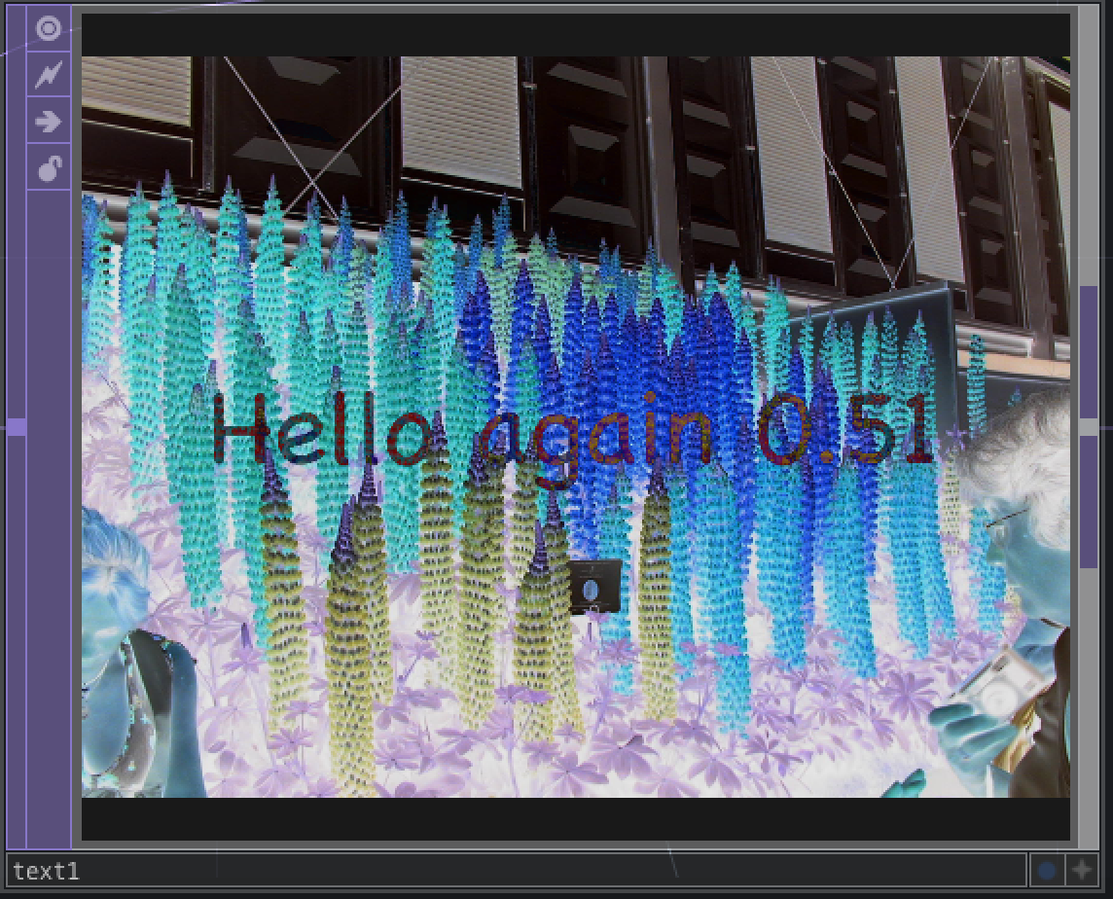
Text TOP https://docs.derivative.ca/Text_TOP
Text TOP is for displaying text in an image or video
Allows for multiple fonts, sizes, colors, borders, character separation and line separation
Text can be displayed as bitmaps, anti-aliased lines or filled polygon characters
Any TrueType font can be rendered and Unicode is supported
Can format lines of text and numbers in decimal or floating point format, reading values from a CHOP using special formatting characters
Can render text strings from a Table DAT, via the specification DAT parameter

Slide 27
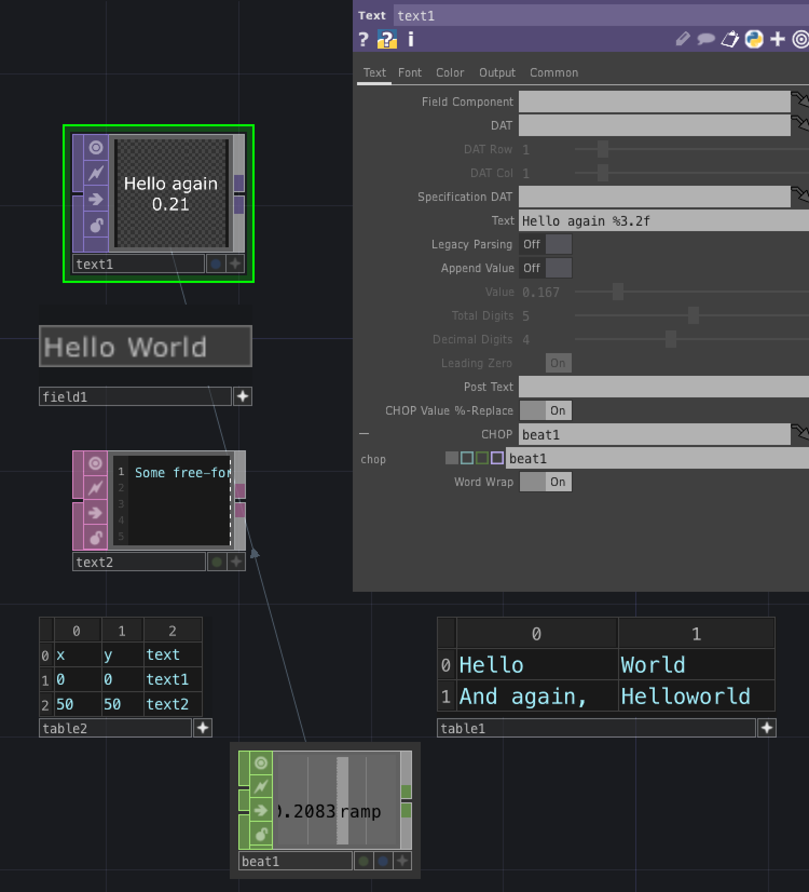
Text TOP – Text Page
Field Component – Specifies a Field COMP operator to use as the source of the text
DAT – specifies a DAT to use as the source of the text
Either drag and drop a DAT onto this field or manually enter the DAT’s path
DAT Row/Col – row and column index of the cell in a DAT Table to use
Specification DAT – a Table DAT that specifies position of the text
Has at least three columns: x, y and text to draw at the position
Text – A string of text to display. Can be optionally followed by a numeric value and another string (defined in Value and Post Text parameters)
If you want special characters (e.g., \n, \t), use a Python expression
Append Value – enables appending of the value in the Value parameter
Value – the value to append to Text
Total Digits – Number of digits in Value
Decimal Digits – Number of digits after the decimal point
Post Text – Text string appended after Text and Value
CHOP value %-Replace – allows for portions of the Text string to be replaced with values specified using the syntax for C’s printf statement: %[flags][width][.precision][type]
Drag and drop a CHOP onto this field
Word Wrap – wrap text so it stays within the TOP’s borders

Slide 28
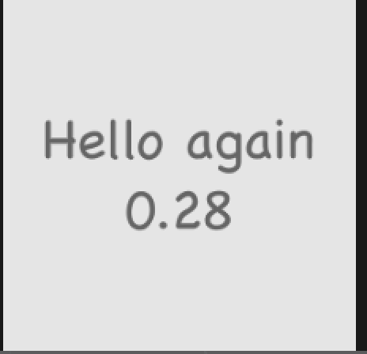
Text TOP – Font and Color Pages
Allow you to control the appearance of the text

Slide 29
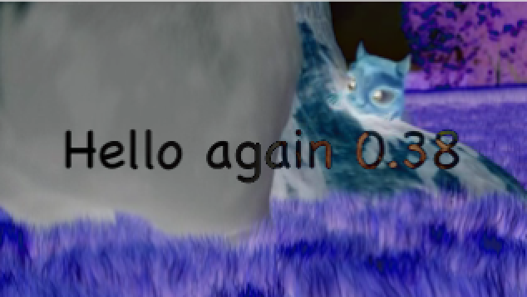
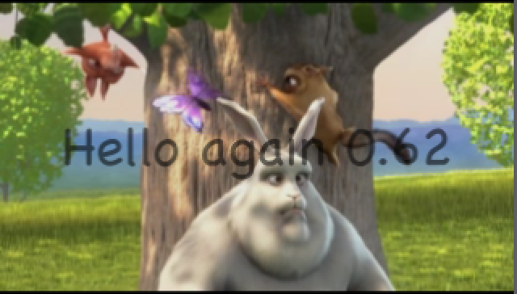
Text TOP – Output page
Controls compositing of text with input image
Comp Over Input – composites input with an image
Operation – choose which composite operation to use to combine the text with the image
Swap Order – Swaps the order of the composite with the input

Slide 30
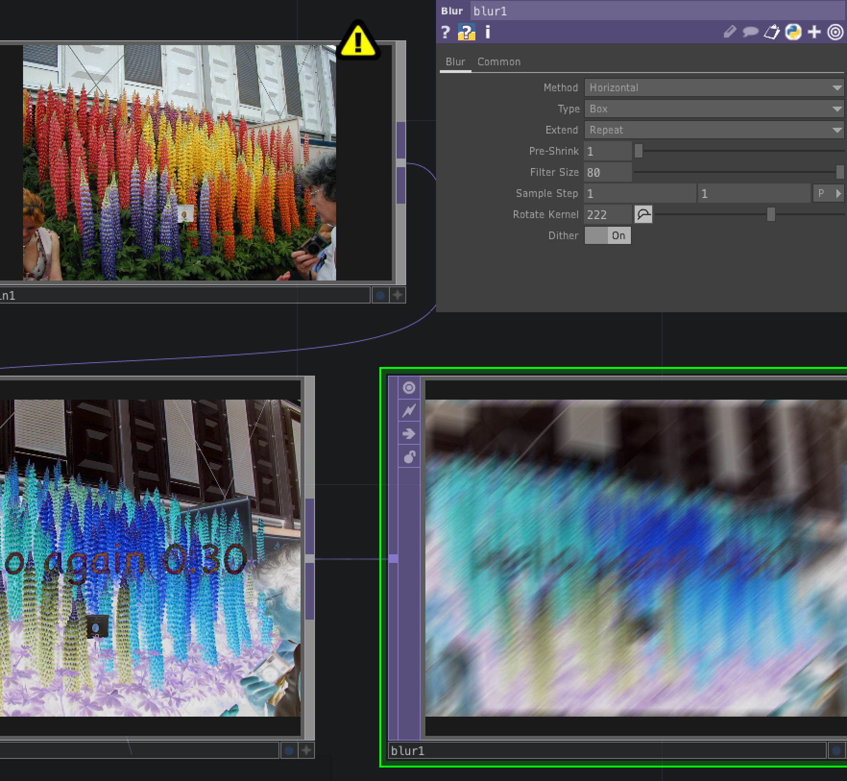
Blur TOP https://docs.derivative.ca/Blur_TOP
Blurs image with various kernel filters and radii
Can do multi-pass blurs and horizontal-only or vertical-only blurs
Can use Pre-shrink to optimize performance when blurs are high
Method determines how blur is applied
Type determines function used to create the blur
Extend sets extend conditions that determine what happens at edge of image
Pre-shrink reduces image’s resolution before applying blur
Filter size is the amount of blur in pixels
Can use me.par.resolutionw/100 * n to give an n% image blur
Sample Step – determines number of pixels away from current pixel sampled to blur the image
Rotate Kernel – rotates the blur filter (noticeable when Method is horizontal)
Dither – enabling makes 8-bit blurs look smoother

